Slide 1
TCSS 551
Big Data Analytics
Lecture 11:
High Dimensionality II - Clustering
Dr. Juhua Hu (juhuah@uw.edu)
|

Slide 2
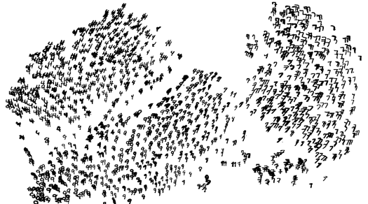
High Dimensional Data
Given a cloud of data points we want to understand its structure

Slide 3
The Problem of Clustering
Given a set of points, with a notion of distance between points, group the points into some number of clusters, so that
Members of a cluster are close/similar to each other
Members of different clusters are dissimilar
Usually:
Points are in a high-dimensional space
Similarity is defined using a distance measure
Euclidean, Cosine, Jaccard, edit distance, …

Slide 4
Example: Clusters & Outliers
x
xx x
x x
x x x
x
x x x
x
x
xx x
x x
x x x
x
x x x
x
x
x x
x x x x
x x x x
x x x
x x
x x
x x x x
x x x x
x x x
x x
x x
x x x x
x x x
x
x x
x x x x
x x x
x
x
Outlier
Cluster

Slide 5
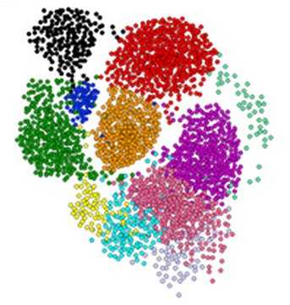
Clustering is a hard problem!

Slide 6
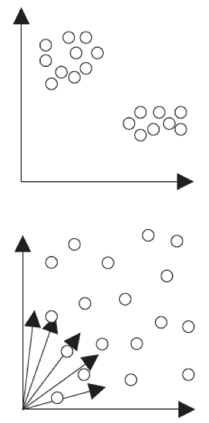
Why is it hard?
Clustering in two dimensions looks easy
Clustering small amounts of data looks easy
And in most cases, looks are not deceiving
Many applications involve not 2, but 10 or 10,000 dimensions
High-dimensional spaces look different: Almost all pairs of points are at about the same distance --> The Curse of Dimensionality

Slide 7
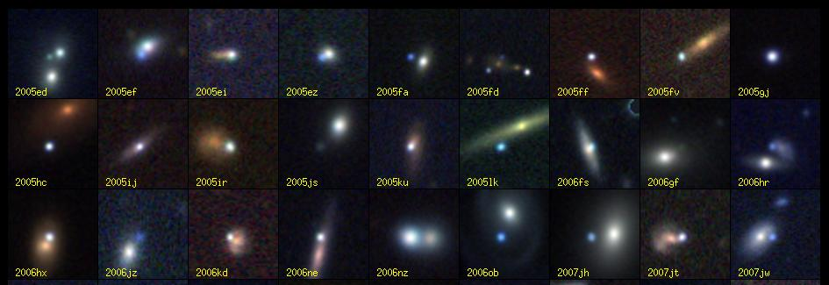
Clustering Example: Galaxies
A catalog of 2 billion “sky objects” represents objects by their radiation in 7 dimensions (frequency bands)
Problem: Cluster into similar objects, e.g., galaxies, nearby stars, quasars, etc.
Sloan Digital Sky Survey

Slide 8
Clustering Example: Music CDs
Intuitively: Music divides into categories, and customers prefer a few categories
But what are categories really?
Represent a CD by a set of customers who bought it
Similar CDs have similar sets of customers, and vice-versa

Slide 9
Clustering Example: Music CDs
Space of all CDs:
Think of a space with one dim. for each customer
Values in a dimension may be 0 or 1 only
A CD is a “point” in this space (x₁, x₂,…, x_{k}), where x_{i} = 1 iff the i ^{th} customer bought the CD
For Amazon, the dimension is tens of millions
Task: Find clusters of similar CDs

Slide 10
Clustering Example: Documents
Finding topics:
Represent a document by a vector (x₁, x₂,…, x_{k}), where x_{i} = 1 iff the i ^{th} word (in some order) appears in the document
It actually doesn’t matter if k is infinite; i.e., we don’t limit the set of words
Documents with similar sets of words may be about the same topic

Slide 11
Cosine, Jaccard, and Euclidean
As with CDs we have a choice when we think of documents as sets of words or shingles:
Sets as vectors:
Measure similarity by the cosine distance
Sets as sets:
Measure similarity by the Jaccard distance
Sets as points:
Measure similarity by Euclidean distance

Slide 12
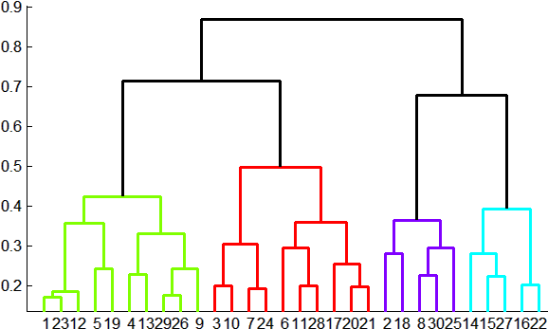
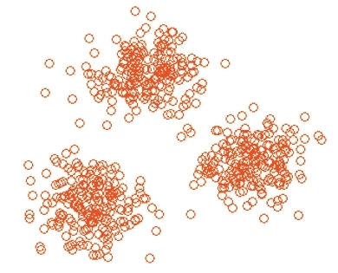
Overview: Methods of Clustering
Hierarchical:
Agglomerative (bottom up):
Initially, each point is a cluster
Repeatedly combine the two “nearest” clusters into one
Divisive (top down):
Start with one cluster and recursively split it
Point assignment:
Maintain a set of clusters
Points belong to “nearest” cluster

Slide 13
Which is Better?
Point assignment good when clusters are nice, convex shapes:
Hierarchical can win when shapes are weird:
Note both clusters have essentially the same centroid.

Slide 14
Hierarchical Clustering
Key operation: Repeatedly combine two nearest clusters
Three important questions:
1) How do you represent a cluster of more than one point?
2) How do you determine the “nearness” of clusters?
3) When to stop combining clusters?

Slide 15
Hierarchical Clustering
Key operation: Repeatedly combine two nearest clusters
(1) How to represent a cluster of many points?
Key problem: As you merge clusters, how do you represent the “location” of each cluster, to tell which pair of clusters is closest?
Euclidean case: each cluster has a centroid = average of its (data)points
(2) How to determine “nearness” of clusters?
Measure cluster distances by distances of centroids

Slide 16
Example: Hierarchical clustering
(5,3)
o
(1,2)
o
o (2,1) o (4,1)
o (0,0) o (5,0)
x (1.5,1.5)
x (4.7,1.3)
x (1,1)
x (4.5,0.5)
Data:
o … data point
x … centroid
Dendrogram

Slide 17
And in the Non-Euclidean Case?
What about the Non-Euclidean case?
The only “locations” we can talk about are the points themselves
i.e., there is no “average” of points
Approach 1:
(1) How to represent a cluster of many points?
clustroid = (data)point “closest” to other points
(2) How do you determine the “nearness” of clusters?
Treat clustroid as if it were centroid, when computing inter-cluster distances

Slide 18
“Closest” Point?
(1.1) How to represent a cluster of many points? clustroid = point “closest” to other points
Possible meanings of “closest”:
Smallest maximum distance to other points
Smallest average distance to other points
Smallest sum of squares of distances to other points
For distance metric d clustroid c of cluster C is:
Centroid is the avg. of all (data)points in the cluster. This means centroid is an “artificial” point.
Clustroid is an existing (data)point that is “closest” to all other points in the cluster.
Datapoint
Centroid
X
Clustroid
Cluster on 3 datapoints

Slide 19
Defining “Nearness” of Clusters
(1.2) How do you determine the “nearness” of clusters? Treat clustroid as if it were centroid, when computing intercluster distances.
Approach 1: No centroid, just define distance Intercluster distance = minimum of the distances between any two points, one from each cluster

Slide 20
Cohesion
Approach 2: Pick a notion of cohesion of clusters
Merge clusters whose union is most cohesive
Approach 2.1: Use the diameter of the merged cluster = maximum distance between points in the cluster
Approach 2.2: Use the average distance between points in the cluster
Which is better?
It really depends on the shape of clusters and we don’t know in advance

Slide 21
Implementation
Naïve implementation of hierarchical clustering:
At each step, compute pairwise distances between all pairs of clusters, then merge
O(N³)
Careful implementation using priority queue can reduce time to O(N² log N)
Still too expensive for really big datasets that do not fit in memory

Slide 22
k-means Algorithm(s)
Assumes Euclidean space/distance
Start by picking k, the number of clusters
Initialize clusters by picking one point per cluster
Example:
Randomly pick k points
K-means++: Pick one point at random, then k-1 other points, each as far away as possible from the previous points

Slide 23
Populating Clusters
1) For each point, place it in the cluster whose current centroid it is nearest
2) After all points are assigned, update the locations of centroids of the k clusters
3) Reassign all points to their closest centroid
Sometimes moves points between clusters
Repeat 2 and 3 until convergence
Convergence: Points don’t move between clusters and centroids stabilize

Slide 24
Example: Assigning Clusters
x
x
x
x
x
x
x
x
x
x
x
x … data point
… centroid
Clusters after round 1

Slide 25
Example: Assigning Clusters
x
x
x
x
x
x
x
x
x
x
x
x … data point
… centroid
Clusters after round 2

Slide 26
Example: Assigning Clusters
x
x
x
x
x
x
x
x
x
x
x
x … data point
… centroid
Clusters at the end

Slide 27
Getting the k right
How to select k?
Try different k, looking at the change in the average distance to centroid as k increases
Average falls rapidly until right k, then changes little
Best value
of k
Average
distance to
centroid
k

Slide 28
Example: Picking k
x
xx x
x x
x x x
x
x x x
x
Too few;
many long
distances
to centroid.
x
x x
x x x x
x x x x
x x x
x x
x x
x x x x
x x x
x
x

Slide 29
Example: Picking k
x
xx x
x x
x x x
x
x x x
x
x
Just right;
distances
rather short.
x x
x x x x
x x x x
x x x
x x
x x
x x x x
x x x
x
x

Slide 30
Example: Picking k
Too many;
little improvement
in average
distance.
x
xx x
x x
x x x
x
x x x
x
x
x x
x x x x
x x x x
x x x
x x
x x
x x x x
x x x
x
x

Slide 31
The BFR Algorithm
Extension of k-means to large data
BFR [Bradley-Fayyad-Reina] is a variant of k-means designed to handle very large (disk-resident) data sets
Assumes that clusters are normally distributed around a centroid in a Euclidean space
Standard deviations in different dimensions may vary
Clusters are axis-aligned ellipses
Goal is to find cluster centroids; point assignment can be done in a second pass through the data.

Slide 32
BFR Overview
Overview of the algorithm:
1. Initialize K clusters/centroids
2. Load in a bag points from disk
3. Assign new points to one of the K original clusters, if they are within some distance threshold of the cluster
4. Cluster the remaining points, and create new clusters
5. Try to merge new clusters from step 4 with any of the existing clusters
6. Repeat steps 2-5 until all points are examined

Slide 33
BFR Algorithm
Points are read from disk one main-memory-full at a time
Most points from previous memory loads are summarized by simple statistics
3 sets of points which we keep track of:
Discard set (DS):
Points close enough to a centroid to be summarized
Compression set (CS):
Groups of points that are close together but not close to any existing centroid
These points are summarized, but not assigned to a cluster
Retained set (RS):
Isolated points waiting to be assigned to a compression set

Slide 34
BFR: “Galaxies” Picture
Points in
the RS
Compressed sets.
Their points are in
the CS.
A cluster. Its points
are in the DS.
The centroid
Discard set (DS): Close enough to a centroid to be summarized
Compression set (CS): Summarized, but not assigned to a cluster
Retained set (RS): Isolated points

Slide 35
Summarizing Sets of Points
For each cluster, the discard set (DS) is summarized by:
The number of points, N
The vector SUM, whose i^{th} component is the sum of the coordinates of the points in the i^{th} dimension
The vector SUMSQ: i^{th} component = sum of squares of coordinates in i^{th} dimension

Slide 36
Summarizing Points: Comments
2d + 1 values represent any size cluster
d = number of dimensions
Average in each dimension (the centroid) can be calculated as SUM_{i} / N
Variance of a cluster’s discard set in dimension i is: (SUMSQ_{i} / N) – (SUM_{i} / N)²
And standard deviation is the square root of that

Slide 37
Actual Clustering
Step 1) From the initial load we select the initial k centroids by some sensible approach:
Take k random points
Steps 2-5) Processing “Memory-Load” of points:
Step 3) Find those points that are “sufficiently close” to a cluster centroid and add those points to that cluster and the DS
These points are so close to the centroid that they can be summarized and then discarded
Step 4) Use any in-memory clustering algorithm to cluster the remaining points and the old RS
Clusters go to the CS; outlying points to the RS

Slide 38
Actual Clustering (cont.)
Steps 2-5) Processing “Memory-Load” of points:
Step 5) DS set: Adjust statistics of the clusters to account for the new points
Add Ns, SUMs, SUMSQs
Consider merging compressed sets in the CS
If this is the last round, merge all compressed sets in the CS and all RS points into their nearest cluster

Slide 39
A Few Details…
Q1) How do we decide if a point is “close enough” to a cluster that we will add the point to that cluster?
Q2) How do we decide whether two compressed sets (CS) deserve to be combined into one?

Slide 40
How Close is Close Enough?
Q1) We need a way to decide whether to put a new point into a cluster (and discard)
BFR suggests:
The Mahalanobis distance is less than a threshold
High likelihood of the point belonging to currently nearest centroid

Slide 41
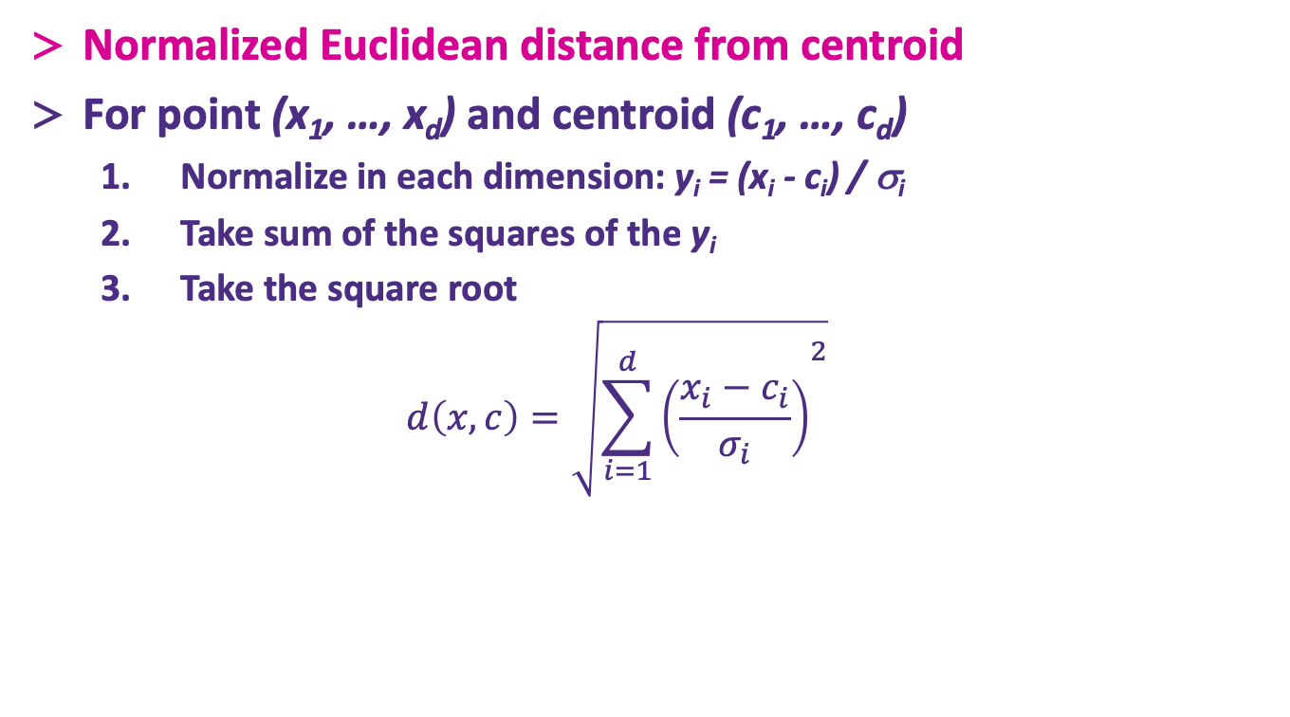
Mahalanobis Distance
Normalized Euclidean distance from centroid
For point (x₁, …, x_{d}) and centroid (c₁, …, c_{d})
Normalize in each dimension: y_{i} = (x_{i} - c_{i}) / σ_{i}
Take sum of the squares of the y_{i}
Take the square root
$$d\left(x,c\right)=\sqrt{{\sum_{i=1}^{d}{\left(\frac{x_{i}−c_{i}}{σ_{i}}\right)}}^{2}}$$
σ_{i} … standard deviation of points in the cluster in the i^{th} dimension

Slide 42
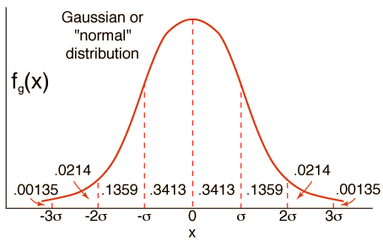
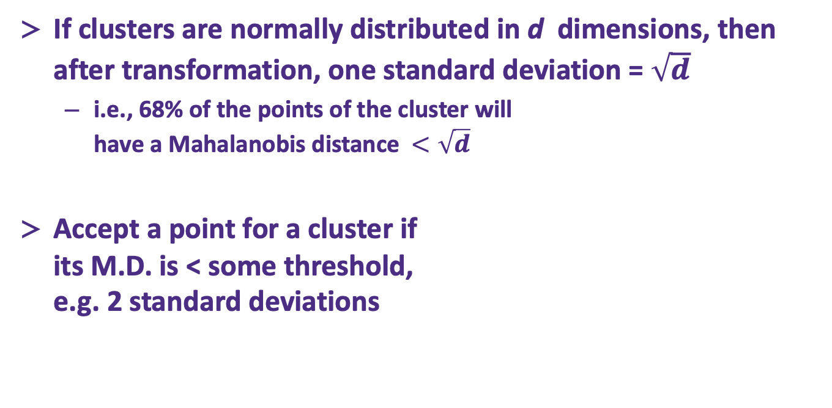
Mahalanobis Distance
If clusters are normally distributed in d dimensions, then after transformation, one standard deviation = $\sqrt{d}$
i.e., 68% of the points of the cluster will have a Mahalanobis distance $<\sqrt{d}$
Accept a point for a cluster if its M.D. is < some threshold, e.g. 2 standard deviations

Slide 43
Should 2 CS clusters be combined?
Q2) Should 2 CS subclusters be combined?
Compute the variance of the combined subcluster
N, SUM, and SUMSQ allow us to make that calculation quickly
Combine if the combined variance is below some threshold

Slide 44
Summary
Clustering: Given a set of points, with a notion of distance between points, group the points into some number of clusters
Algorithms:
Agglomerative hierarchical clustering:
Centroid and clustroid
k-means:
Initialization, picking k
BFR

